Slide 1
Show notes:
1. THIS IS A SQUARE FORMATTED SHOW
Zoom the projector to fill the screen
top-to-bottom with this slide.
3. Focus on this slide
4. Hide this slide (Slide Show/Hide Slide) and begin on the ASRAS title slide.
(see additional notes below for this slide)
HIDE THIS SLIDE
Notes:
Notes continued: many slides do not need comment but are there to let the audience have a visual understanding. Talk in general during the introduction, specific topics will be covered later. Many bullet lists don’t require reading and may not need extensive comment. Expand as you wish. An outline or more information about a slide may be below in the slide notes. Put that information into your own words. Try for a slide show of no more than 25 minutes, not counting a Welcome and Q&A following. Your entire presentation will fit within 1 hour. With 100 slides at about 10 sec/ slide (a long time for some) the show is a minimum of 16 minutes, 20 sec/slide makes it a half hour– an audience attention span. Please keep moving. Some slides have transitions-- after first click, additional material will appear within that slide. Just keep clicking.

Slide 2
ASRAS at Ionia
Produced by Don Chamberlin 2012
Notes:
Commonly known as the Rochester Astronomy Club we are a diverse group of fun-loving people who love the sights of the space above and around us. We have facilities away from bright city lights in the little hamlet of Ionia.

Slide 11
Tour of facilities

Slide 12
Notes:
Our observatory is lost in a woods on the western edge of the hamlet of Ionia.

Slide 14
Notes:
Our education building houses a large classroom, basement, and large deck for community gathering and EATING (a theme in the show).

Slide 15
Notes:
Our 6 telescope buildings are perched high on Farash Hill.

Slide 18
Notes:
The “Big Dome,” as we call it has a clam shell opening roof housing a 12-inch Schmidt-Cassegrain scope driven by computer from a warm room below.

Slide 19
Notes:
Just now in 2012 we have built a new roll-off building housing a Solar telescope made for studying the sun in safe, filtered light. A roll-off building is one which the roof rolls back onto supports, revealing the sky.

Slide 21
Notes:
The U of R gave us an old dome from the top of one of their buildings which we cleaned and mounted to house one of their outdated 12-inch Cassegrain scopes. A club member’s optical business, refurbished the scope which now resides in this dome.

Slide 23
Notes:
Our first roll-off building was made to house our 16-inch, Cave Optical Co. scope, the one we use most for groups. Club members may use any of the scopes, after initial instruction and many rely on such equipment as their only access.

Slide 24
Notes:
In astronomy, bigger IS BETTER! Larger mirrors or prime lenses gather more light. We are interested in the dim objects, as we’ll see later on. This scope has a 16-inch mirror. Magnification is acquired by using more powerful eyepieces, but usually at the expense of sharpness. We typically observe using 100 to 200-times mag.

Slide 25
Notes:
In this type of REFLECTOR telescope starlight is reflected off the curved mirror deep within the tube up to the small diagonal pictured below, and reflected once again up to focus at the eyepiece.

Slide 27
Notes:
A special filter can allow safe viewing of the Sun.

Slide 29
Notes:
If 16-inches is big, how about a 20-inch mirror on a Dobsonian-type mount! This mounting system originated from San Francisco and makes for light –weight, more portable scopes. (more later)

Slide 30
Notes:
Many members own their own scopes and may use the electrified pads and grounds on club observing nights.

Slide 31
Notes:
Our Ionia property provides us with safe, dark-sky locations where we can stay all night. Most parks have closing hours of about 10:00 or 11:00.

Slide 32
How it all started

Slide 33
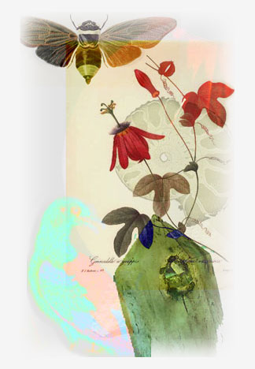
Rochester Academy of Science
Established in 1881
Astronomy
Anthropology
Life Sciences
Mineral
Fossil
Notes:
The 1880s was a fabulous decade for science, invention, and business start-up! Rochester was a growing place for technical ideas. The Rochester Academy of science formed in 1881 to bring together people with interests in Astronomy, Anthropology, Life Sciences, Minerals, and Fossils. These groups are active today with the Botany section the only continuously active group.

Slide 34
Lewis A Swift
Amateur Astronomer
Comet Hunter
109P Swift/Tuttle
11P Tempel/Swift/LINEAR
Warner Observatory
Notes:
Lewis A. Swift’s influence in Rochester is a parallel example to our club’s objective—to enjoy the sky. Born in Clarkson and a member of the R. Academy of Science, he became interested in comets and astronomy as a boy on observing a comet before it was announced by professionals. Though becoming a hardware store owner in 1854, he pursued observation with a scope of his own making. He became well known in Rochester, observing atop the flat roof of Duffy’s cider mill. His accuracy of observation lead to becoming a professional, though he did not hold an academic degree. A number of sightings carry his name. He was known for allowing visitors to watch him and view through his scope. An observatory was built for him by H.H. Warner Co. at Ambrose St. and East Avenue known as Warner Observatory . Comet Swift/Tuttle is probably the cause of the Perseid Meteor Shower of mid-August. It is believed to be Comet Kegler observed in 1737, “discovered” on its pass 1862 (Swift & Tuttle), and rediscovered again in 1992 at which time its 120 year orbit was better calculated. Its next pass or collision will be in 2126.

Slide 35
RAS: scientific organization
Amateurs welcome
Modern organization Mid-1920s
Open lectures at UR Physics, Dr. Floyd Fairbanks
Rochester Astronomical Soc.—
1932
Affiliated with Rochester Academy of Science-- 1945
Notes:
RAS took on more organization in the mid-1920s. Our Astronomy Section was founded in 1932 and became affiliated with RAS after WWII-1945.

Slide 36
A S R A S
WWW.rochesterastronomy.org
Notes:
The club took on an official look with a logo designed by a Rochester Jeweler. In the internet-age we are known by our URL www.roc. . . .org web page where you should go for more information about our activities.

Slide 37
Diverse membership
Optical organizations: B & L, Kodak, Wollensak Optical, others
Occupations: Rev. John Betlam-sheet metal, Stonecutter & teacher-Edison Tech, Lincoln Alliance Banker, Commercial Photographer
Notes:
From its earliest days the Astronomy section brought together technical people as well as others with just an interest in the sky.

Slide 38
Contributions
Observing sessions– Lunar eclipses
Lectures
Projects: MOONWATCH
observing and cataloging artificial satellites for the Smithsonian. Observing breakups, passovers before radar.
Notes:
[FYI: After Sputnik (1957) and before radar tracking facilities, the Smithsonian Astrophysical Observatory used about 90 organizations world wide to report on artificial satellites. Between 1956 and 1975 they made 5796 sightings of 542 space objects. Smithsonian required highly accurate positional data of a certain few objects for their studies of the earth's shape and gravity fields. They supplemented radar data for such purposes as proper separation of launch components, tumble rates, balloon inflation, decay characteristics, and orbit maintenance of objects inaccessible to radar because of range. , Rochester earned the, reputation for making precise, reliable observations with a timing accuracy of 0.2 sec and position accuracy of 41 of arc.
From: Roc Academy of Science history:http://www.rasny.org/ (Monroe Co. Library) ]

Slide 39
The John Dobson Era
1960s and Amateur Astronomy
Telescope maker
The Dobsonian Mount
San Francisco Sidewalk Astronomers
1968 Edmund Sci. Catalog
Notes:
Amateur astronomy took off in the 1960s when John Dobson cobbled together a new way of appreciating the night sky– at about 1/10th the cost. Previously you had to buy commercially or make your own components. Dobson began grinding mirrors from bottoms of gallon jugs or porthole glass. He began making bigger and bigger Newtonian telescopes then mounted them on an ingeniously-designed plywood mount. Observing became portable. He and others took the idea to the sidewalks of San Francisco and around the world.

Slide 40
What we do today
Monthly Meetings
Young Astronomers
RocheStarfest
OUTREACH:
Star Parties
Scout groups
Strasenburgh
Planetarium
UR Mees Observatory
Notes:
(We will expand on each of these topics)

Slide 41
Monthly Meetings

Slide 42
At RIT

Slide 44
Young Astronomers
Notes:
A newly formed group is for kids and gets them involved in science and astronomy.

Slide 45
Notes:
Did I mention we like to eat!

Slide 46
RocheStarfest
Notes:
Each summer in July we hold a day-and-a-half event we call RocheStarfest. A family gathering, it involves kids activities, special talks, demonstrations and . . .

Slide 47
Notes:
. . . A silent auction where we are glad to buy each other’s junk.

Slide 49
Notes:
We also have a lot of very nice donated door prizes. These and the entrance fee are money-raisers for the club.

Slide 50
Peter Blackwood
Notes:
Before dinner we gather for a group picture.

Slide 51
Notes:
THEN WE EAT! This year’s desert cake recognized the Transit of Venus across the Sun. It was complimented with site-grown blackberries and ice cream.

Slide 52
Al Russell
Notes:
In the evening we listen to featured talk and open the scopes for viewing.

Slide 53
Ionia Fall Festival
September 15th
Hayrides
Tractor Parade
Eats
ASRAS tours
Dark Sky Observing 8pm

Slide 54
Scout Groups
Notes:
Part of our outreach includes Scout Groups who camp out and learn about the heavens.

Slide 57
Star Parties at Mendon or North Hampton Parks
Notes:
Throughout the Summer and into the Fall we conduct Star Parties at Mendon and North Hampton Parks.

Slide 58
Planetarium Support
Notes:
Since the Strasenburgh planetarium opened in 1968 we’ve supported its activities.

Slide 59
Notes:
Before Christmas we demonstrate telescopes. . .

Slide 60
Telescope Info

Slide 62
Kid’s Vacation Activities
Notes:
. . .and offer Kids activities in the lobby during vacation breaks.

Slide 66
Open Scope Each clear Saturday night
Notes:
Up 60 steps to a roll-off-roof platform are 2 telescopes operated by ASRAS people since it opened in 1968. Probably 35 to 150 people a night make the climb for first-time sightings of Jupiter, Saturn, star clusters, or the Moon, or what is available.

Slide 67
Notes:
The planetarium has 2 scopes– a 12 ½-inch Cave Optical and an 8-inch Dynascope.

Slide 69
Notes:
The University of Rochester owns land and an observatory in the Bristol Hills. Each summer tours of the grounds are conducted by ASRAS members and UR students.

Slide 70
Notes:
We end the night peering through a professional 24-inch Cassegrain scope—when the nights are clear.

Slide 71
What is up there
Notes:
Let’s take a look at the variety of things that gets us so interested.

Slide 72
Notes:
In early June (2012) we were treated to an event not to come around again for 120 years– a Transit of Venus. Venus crossed in front of the Sun just in time for Rochester to view it before the sun set. SPECTACULAR!

Slide 73
Notes:
Hundreds of Rochestarians got to see and photograph it.

Slide 74
Notes:
Evenings in our area present us with a Winter sky dominated by Orion, the Hunter.

Slide 75
Notes:
The winter sky is dominated by the connect-the-dot figure of Orion, the Hunter with his 3-star belt and sword below. The center star in his sword (visible with binoculars) is the Orion Nebulae where stars are being formed.

Slide 76
Notes:
We learn to connect the dots and see Ancient characters and a whole zoo of animals. Here we also see a naked-eye object—the Perseus Double Cluster. (better with binoculars)

Slide 77
Notes:
As you become familiar with the seasonal night sky, you become better grounded in your place in the Universe.

Slide 78
Notes:
Just over Bloomfield hangs the Teapot in Sagittarius and the center of our Milky Way Galaxy.

Slide 79
Notes:
Jupiter with its 4 Galilean moons visits us during the winter. The moons are just visible with binoculars.

Slide 80
Notes:
Mars is not generally spectacular on direct observation, but by taking 1000 shots, selecting the best 230, and processing them in a computer program Bob McGovern produced a nearly Hubble-like image. Turbulence in our atmosphere (like the view across a hot parking lot) makes direct observation challenging.

Slide 81
Notes:
But one sight that brings an “Oh Wow!” is Saturn. A late spring through summer pleaser, Saturn is a favorite. We can usually make out atmosphere stripes or divisions in the rings with steady seeing.

Slide 82
Notes:
Saturn tilts as it makes its ~30-year journey around Sun. We are just coming off the lower tilt where the rings were nearly edge-on.

Slide 83
Joy of the sky
Notes:
Some of our members do astrophotography using their own or the club’s equipment. Let me share a variety of our sky favorites.

Slide 84
Notes:
Transit of Venus at sunset.

Slide 85
Notes:
Some full moons are fuller than other. But it is not the best time for observing. . .

Slide 86
Notes:
. . .a better time for enjoying the moon either in a telescope or binoculars is best about the first quarter of the month.

Slide 87
Notes:
Winter skies are announced by the appearance of the Pleiades, a tight little nearby open cluster often mistaken for “the Little Dipper”. These young blue stars reflect dust clouds nearby.

Slide 88
Notes:
Open clusters are balls of hundreds to a few a thousand stars orbiting within our galaxy arm. They are generally young, having been formed from the same material about the same time.

Slide 89
Notes:
Occasionally a comet passes within sight. Notice the fuzzy spot in the center.

Slide 90
Notes:
There are a few hundred tight globs of stars swarming around our galactic disk. These globes contain millions of stars and pre-date the 9-billion year age of galaxy itself.

Slide 91
Notes:
Space is spacy, but concentrations of gas and dust known as nebulae can be seen and photographed. Your eye is not color sensitive to dim light but through long exposure photography hydrogen appears as pink/red as it is excited by stars’ ultraviolet light. Blue areas are dust clouds reflecting visible light. The Trifid nebulae is off the spout of the Tea Pot in Sagittarius. Also visible with naked eye or binoculars.

Slide 92
Notes:
Certain filters make some nebulae directly visible in black-and-white, but photography brings out the color.

Slide 94
Notes:
Some nebulae are gas remnants of an exploded star called a supernova.

Slide 96
Notes:
The large North American Nebulae is seen here on its side.

Slide 97
Notes:
The middle star in Orion’s sword is actually a quartet of new stars which illuminate the gas and dust from which they were formed. The process is continuing . . . or continued as we now see it 1300 years later.

Slide 98
Notes:
To the naked eye and even directly in a scope, galaxies look like fuzzy blobs or ovals. But photography brings out arms and lanes of gas and dust.

Slide 100
Notes:
Our closest galaxy neighbor is a mere 2.3 million ly away– the Andromeda Galaxy. Though nothing but a smudge in the northern sky by eye, but we see only the central smudge and 2 satellite galaxies in a scope. Long camera exposure brings out full detail of a galaxy much like our own.

Slide 101
The Future

Slide 102
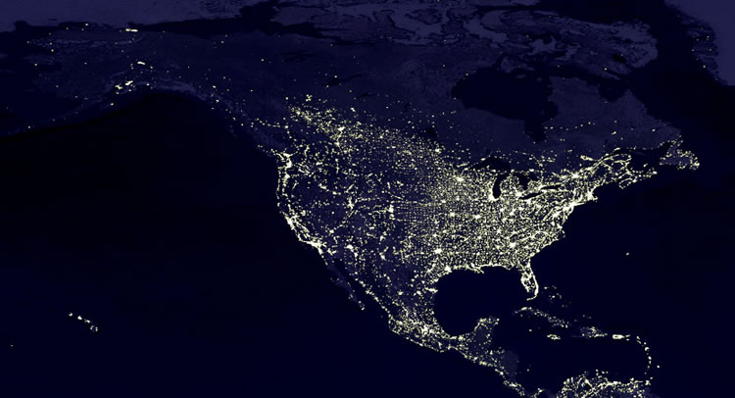
Cloud-free Satellite view of N. America
Notes:
(Pause). . . A beautiful sight. But this “beauty” has concern for astronomers– amateur or professional. Almost like an atlas view of North America.

Slide 103
Notes:
Chicago, Detroit, Cleveland, Buffalo and even Rochester and Ottowa. Our earth is becoming less dark.

Slide 104
Notes:
Even at Ionia we have a glow off of Rochester in the northern sky. We are concerned about loosing our dark skies.

Slide 105
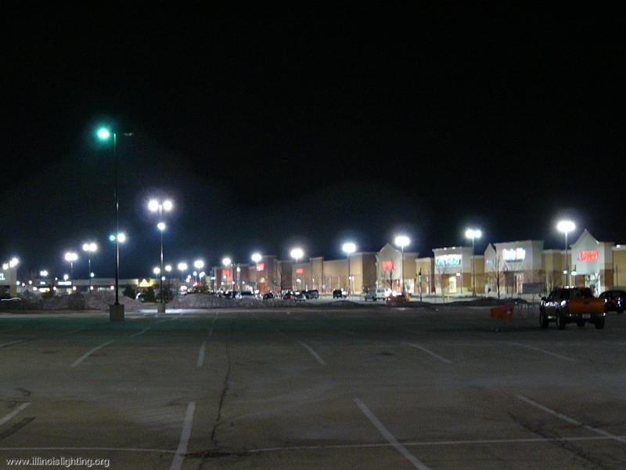
Example of bad lighting
Notes:
Urban expansion doesn’t have to mean loosing the dark skies.

Slide 106
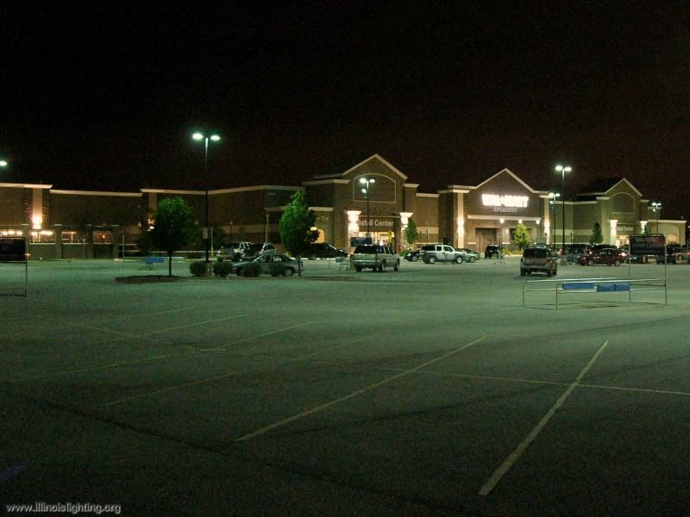
Example of good lighting
Notes:
Consider making your voice be heard for Dark Skies, friendly construction in new city planning. . .

Slide 107
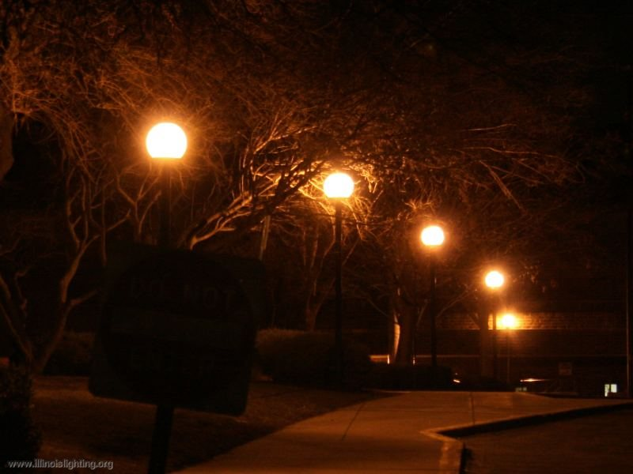
Example of Bad Lighting
Notes:
. . . New residential developments.

Slide 108
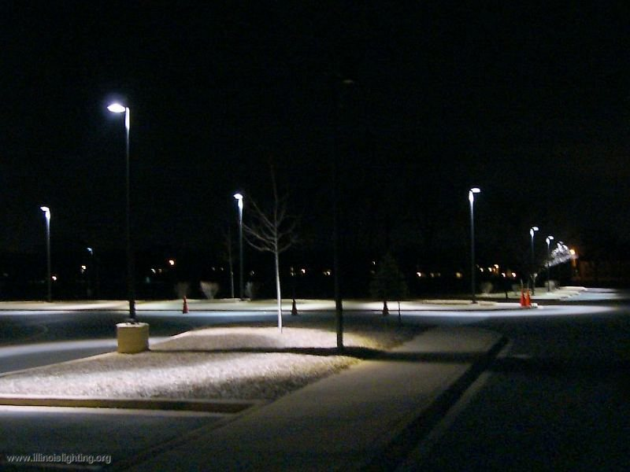
Example of good lighting
Notes:
Lighting that directs light down and prevents spill upward still puts the light where needed and is more efficient and economical.

Slide 109
Start at Home
Notes:
You can begin at home by choosing Dark-Skies approved lighting. Direct the light downward where needed not by spreading it throughout the neighborhood.

Slide 110
Notes:
Look for lighting approved by The International Dark-Skies Association at lighting suppliers. You’ll enjoy being in the dark.

Slide 111
Goodnight . . . and Clear Skies.
www.rochesterastronomy.org

